Slide 1
Capstone
Concepts of ADAS - Advanced Driver Assistance System
Traffic signs classification & Grad-CAM (Gradient-weighted Class Activation Mapping)
Object localization
OpenCV with DNN - YOLOv4 bounding box trajectory tracking
Notes:
Hi guys, today i’ll be presenting my capstone project on ‘Concepts of ADAS’ or Advanced Driver Assistance System.
Let me introduce ADAS.
So, what is ADAS?

Slide 2
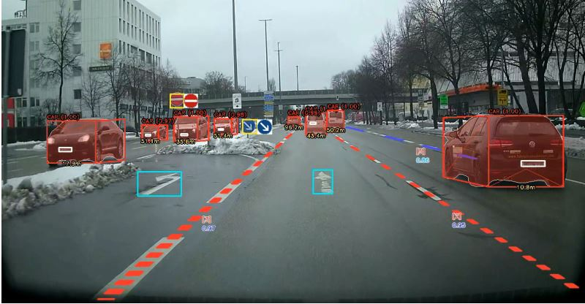
Example of ADAS [18]
1. Object Classification & Detection
Traffic Signs Classification & detection
2. Stereo Camera 3D Bounding Box
3. Depth perception
4. Semantic Segmentation
Lane Detection
Road direction signs classification & detection
Notes:
ADAS is a series of rule based & deep learning problems mainly related to computer vision to assist drivers to ‘see’ and ‘react’ better when on the road.
Deployment of computer vision in automotive vehicles have a set of unique requirements. They are required to 'see' like humans, classify pedestrians, street signs, vehicles, road hazards and localize these objects in their field of view.
Traffic signs classification & localization is a topic where it has value owing to traffic signs containing critical information about:
Stop signs - Mandatory stop
Entrance to highway - Build up speed for merging onto highway
Pedestrian crossing - Slow down where pedestrians are expected
Speed signs - Speed limits
Etc.
Object detection is also a critical part of ADAS where the system has to detect and track the object as it moves to detect vehicles and vulnerable road users.

Slide 3
Problem Statement
Accidents on the road are not acceptable. Regardless whether rates are increasing or decreasing, no lives should be lost through accidents.
With the development of Stereo cameras and LiDAR, it is now far more possible to prevent road accidents through vision systems and deep learning. Object tracking and traffic signs detection methods can potentially be expanded to detect hazards on the road, and provide audible or haptic feedback.
With the development of pre-trained models like YOLO, SSD, Faster-RCNN and frameworks like Tensorflow, object detection has been a lot more reliable than before. [1]
Notes:
Now, for the problem statement.
Accidents on the road are not acceptable, regardless whether rates are increasing or decreasing, no lives should be lost through accidents.
With the development of Stereo cameras and LiDAR, it is now far more possible to prevent road accidents through vision systems and deep learning. Object tracking and traffic signs detection methods can potentially be expanded to detect hazards on the road, and provide audible or haptic feedback.
With the development of pre-trained models like YOLO, SSD, Faster-RCNN and frameworks like Tensorflow, object detection has been a lot more reliable than before. [1]

Slide 4
Scope
Scope of the project:
1. Traffic signs classification
2. Activation region visualization - GradCAM
3. Object localization
4. Object tracking and detection algorithm using trajectory tracking and deep learning models.
a. OpenCV with DNN module - YOLOv4
Notes:
The scope of this project covers:
Traffic signs classification
GradCAM model interpretation and explainability
Object localization - in terms of bounding box
Object tracking and detection algorithm using trajectory tracking and deep learning models like YOLOv4 with OpenCV

Slide 5
Traffic Signs Classification
Notes:
First off, traffic signs classification.

Slide 6
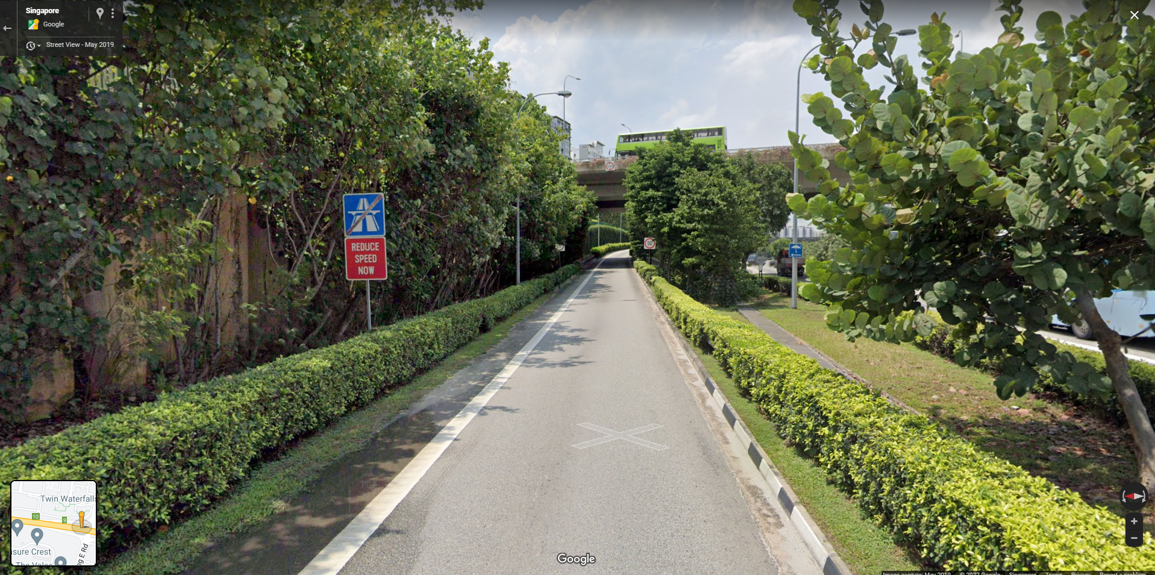
Data Collection - Google Street View
Notes:
The data collection was through Google Street View and through a github user which i credited in my own Github readme.

Slide 7
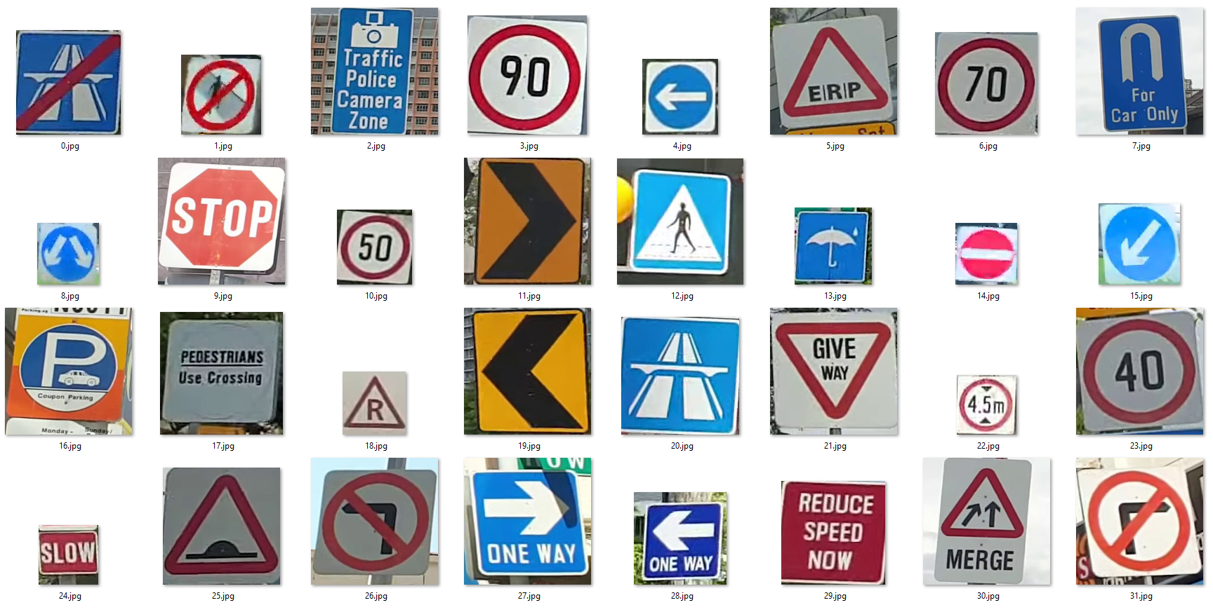
Data Set
Notes:
There were a total of 32 classes of different traffic signs. And, as many variations of it, example, ‘new signs or worn out signs’, were collected as possible.

Slide 8
Data Distributions
Notes:
For the EDA, I explored the data distribution.

Slide 9
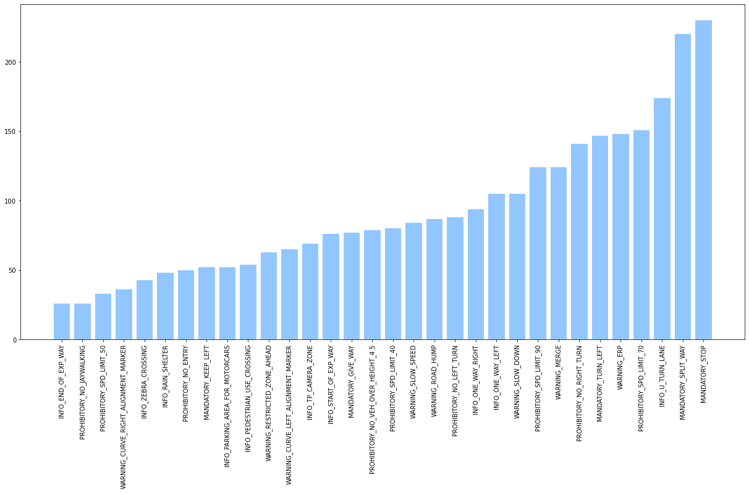
Data Distribution
Notes:
A healthy amount of images, ranging from 40 to 200, were collected across the classes with enough images for the model to be trained.

Slide 10
Conventional ML - XGBoost
Notes:
Firstly, i started off using conventional ML, with the XGBoost model.

Slide 11
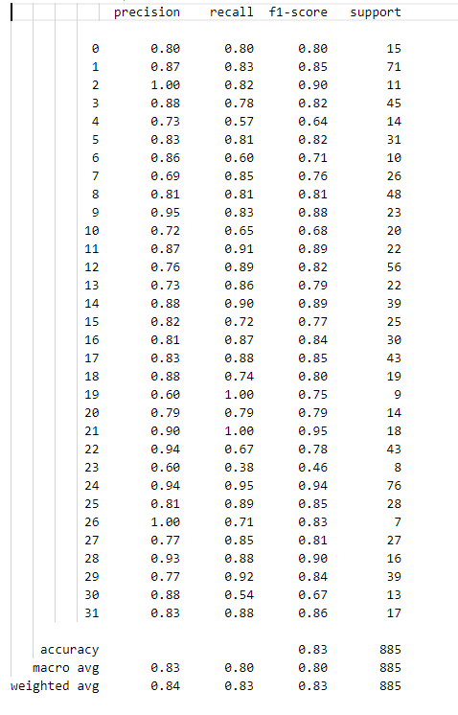
Conventional ML - XGBoost
XGBoost was used to get an idea of how conventional ML model scores on image datasets.
Accuracy score of 0.83
https://stackoverflow.com/questions/61573260/reshape-3d-numpy-array-of-images-to-2d-numpy-array-for-xgboost-dmatrix-input
Notes:
I used XGBoost without any hyperparameters tuning to get an idea of how conventional ML scores on computer vision problems.
I got an accuracy score of 0.83 which was reasonable but definitely not the best, especially considering how accurate the automotive industry requires the traffic signs classification to be.

Slide 12
Convolutional Neural Network
Notes:
Next, Con-vo-lu-tio-nal Neural Network.

Slide 13
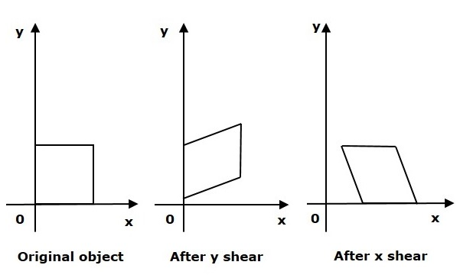
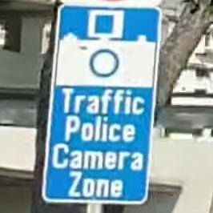
Creating variations in dataset
https://www.analyticsvidhya.com/blog/2020/08/image-augmentation-on-the-fly-using-keras-imagedatagenerator/
https://www.tensorflow.org/api_docs/python/tf/keras/preprocessing/image/ImageDataGenerator
https://stackoverflow.com/questions/57301330/what-exactly-the-shear-do-in-imagedatagenerator-of-keras
Keras Image Data Generator:
Image Generator was used to replace the training images with random:
Shifts
Rotations
Random magnification
Image Shear/Distortions
https://stackoverflow.com/questions/57301330/what-exactly-the-shear-do-in-imagedatagenerator-of-keras
Notes:
Deep learning in computer vision problems is unique, it requires variations in the images to train well.
I used a synthetic method called the Keras Image Data Generator to replace the training images with random:
Shifts
Rotations
Random magnification
Image Shear/Distortions
What it does is it simulates real life camera distortions and shears the image to simulate the natural lens distortion and also what the camera sensor ‘sees’ when the car speeds up and this allows the model to learn better.

Slide 14
Sequential
Feature Extraction
Multi-Classification
Softmax
Input
Convolution 16
Convolution 32
Max Pooling
Batch Normalization
Convolution 64
Convolution 128
Convolution 256
Convolution 532
Max Pooling
Batch Normalization
Max Pooling
Batch Normalization
Flatten
Dense 1024
BatchNormalize
Dropout 0.5
50x50
Dense 32
Notes:
I explored the Sequential model with the feature extraction layers and the dense layers.
There are 3 layers within the feature extraction layer.
And each of the ‘Feature Extraction’ layer consists of 2 Convolutions, 1 max pooling and 1 batch normalization.
The batch normalization was added to normalize the inputs to the next layer and helps the model to learn better with lesser epochs.
The dense layers included a dropout of 0.5 to prevent overfitting and to prevent the model from becoming too weight dependent.
Softmax activation was used because it is a classification problem and it gives class probabilities.

Slide 15
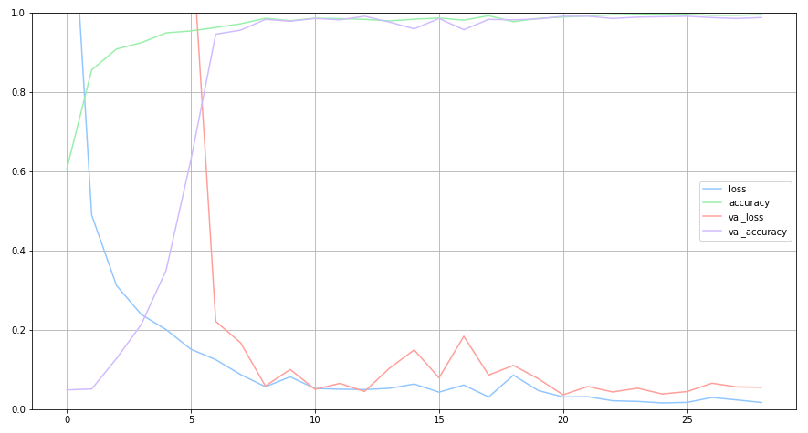
Training History
Notes:
Using 30 Epochs with early stop callbacks, the training history looks fairly good & smooth, and the model converged nicely with a fairly good accuracy with no exploding losses.

Slide 16
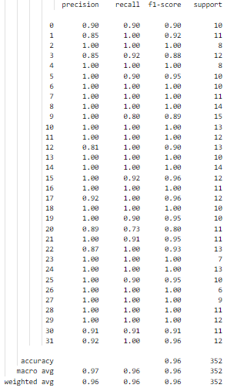
Keras - Results
Model is fairly accurate in predicting traffic signs:
Accuracy: 0.96
Notes:
Using the sequential model, i achieved an average accuracy score of 0.96.
Now, let’s visualize the results.

Slide 17
Classification Results
Notes:
Now, for classification visualization results

Slide 18
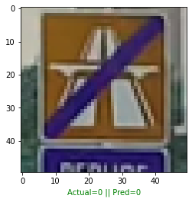
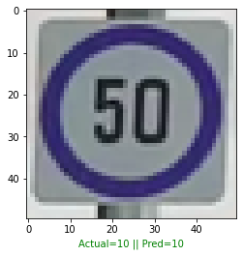
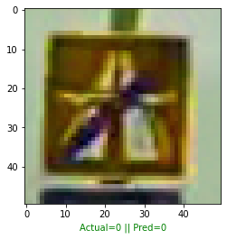
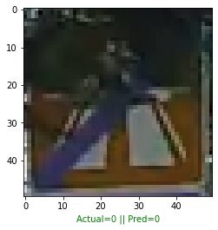
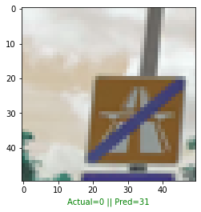
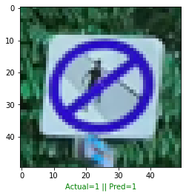
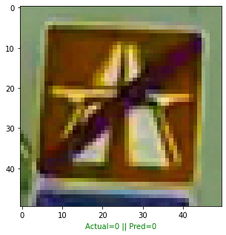
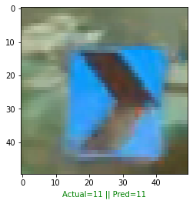
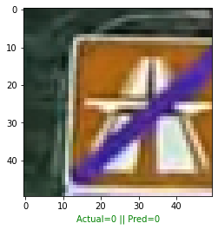
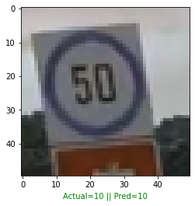
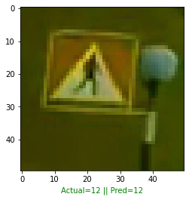
Image Classification
Notes:
Looking at the validation set, we can see that there are still images that the model failed to classify correctly, the image ‘squared up’ in red had the wrong class predicted.
How do we ‘see’ what the model ‘sees’ to know for sure that it has learnt the features correctly?

Slide 19
Interpretation & Failure Analysis
Notes:
Here, we explore model explainability and perform failure analysis.

Slide 20
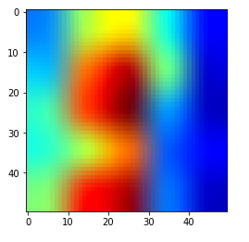
Image Interpretation - Gradcam
https://github.com/kolesman/SEC
Seed, Expand, Constraint, paper for weakly supervised image segmentation
GradCAM’s activation heatmap
Notes:
GradCAM is a concept of model explainability. It allows us to look into the convolution layers to ‘see’ what the model ‘sees’ in each image class for class recognition.
The heatmap represents the gradient flowing into the convolution layers during training.

Slide 21
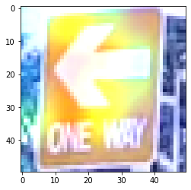
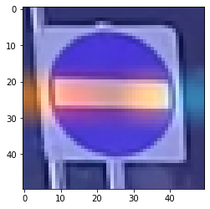
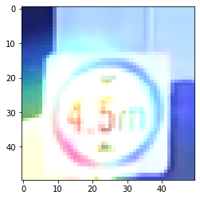
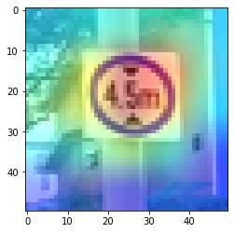
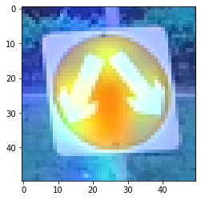
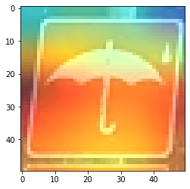
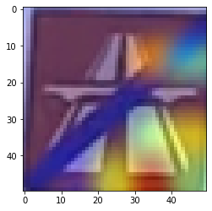
Image Interpretation - Gradcam
Activation Heatmap
Correct classification images
Notes:
Using GradCAM, we are able to visualize how the model interprets each sign.
The model sees the ‘STOP’ sign by recognizing the horizontal bar across the image.
The ‘SPLIT WAY’ sign is recognized by looking at the 2 arrows.

Slide 22
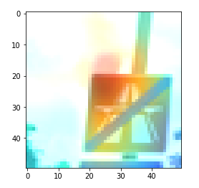
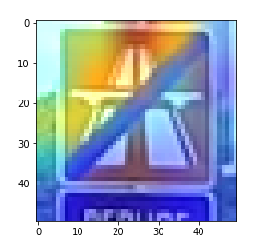
Analyze failed classification for improvements
Wrongly classified images
Wrong region activated
Notes:
Here, we look at 2 images of the same class.
The one on the left was classified wrongly while the one on the right was classified correctly.
For this image class, ‘End of Expressway’, the model looks at its defining feature, just half of the image because of the center slash, to recognize this is the ‘End of Expressway’ sign.
However, in the failed classification sign, the model was looking at the sign AND the sky.
To solve this problem, new images with different background variations could be introduced to allow the model to learn even better.

Slide 23
Object Localization
Notes:
Next, object localization.

Slide 24
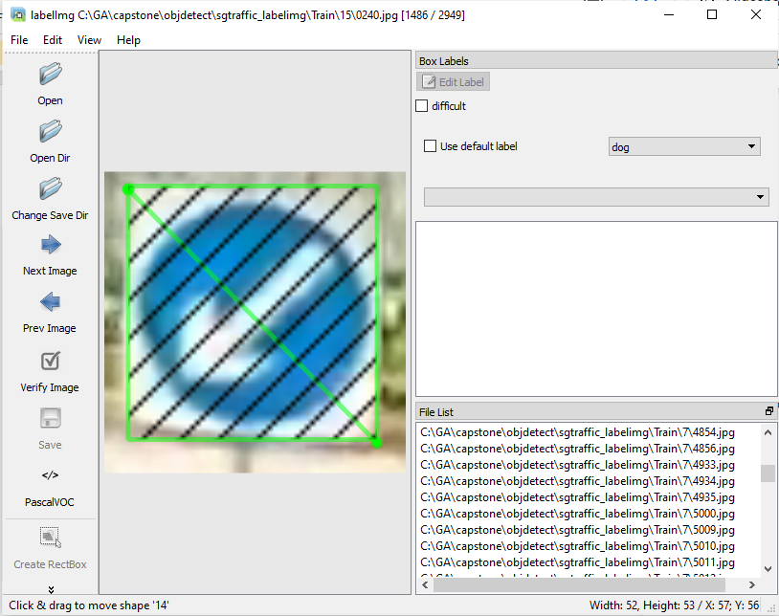
LabelImg
Hand Labeling images in PascalVOC format to generate XML files.
Contains:
Bounding box coordinates
Image class
Path
Image size
Notes:
For object localization, the thousands of images were hand labeled using the PascalVOC format to generate XML files.
It contains information about bounding box coordinates, image class, path and the image size to be parsed afterwards.

Slide 25
Model Architecture
Notes:
Building upon the classification model architecture.

Slide 26
Transition from Sequential to Functional Model
Classification
Softmax
Feature Extraction
Dense 1024
BatchNormalize
Dropout 0.5
Dense 32
connected
Input
connected
Sigmoid
Convolution 16
Convolution 32
Max Pooling
Batch Normalization
Convolution 64
Convolution 128
Convolution 256
Convolution 532
Max Pooling
Batch Normalization
Max Pooling
Batch Normalization
Flatten
50 x 50
With target vertices
Dense 1024
Dense 532
Dense 256
Dense 128
Dense 64
Dense 32
Dropout 0.1
Dense 4
Localization
Notes:
For the localization, I transitioned the model from a sequential to a functional model by keeping the base layers and connecting the classification branch.
A new localization branch was created here using sigmoid activation as bounding box is a regression problem.
An architecture like this allows the localization vertices to be mapped upon the feature map simultaneously during classification.
This architecture follows the Fast R-CNN architecture closely and like the name suggests, gives fast predictions which i will demonstrate later.

Slide 27
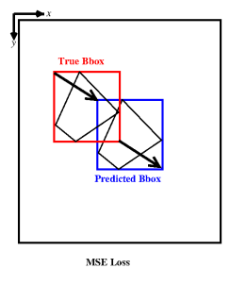
Loss for the model - MSE
Notes:
The loss for the model was MSE or Mean Square Error as it tells the model how far it is away from the groundtruth.
And this allows the model to learn how much it needs to offset during the training.

Slide 28
Localization Metric - IoU
Notes:
Metric

Slide 29
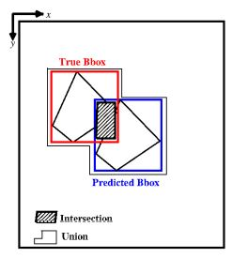
IoU - Intersection over Union
Notes:
The metric used for localization was IoU or Intersection over Union.
This metric tells us how accurate it is from the groundtruth.

Slide 30
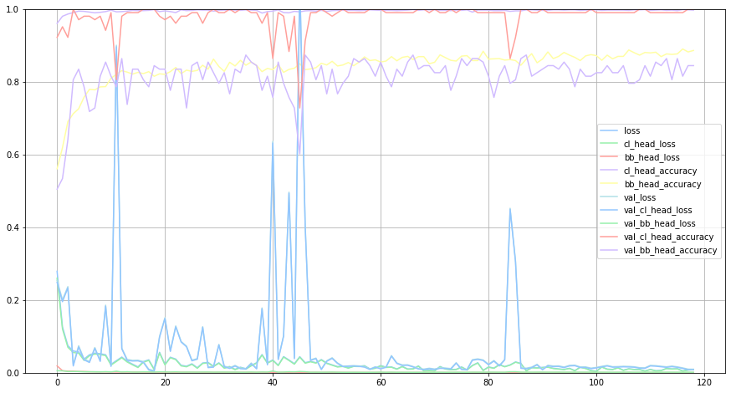
Training History
Classification & Bounding Box Regression
Bounding Box Accuracy
Classification Accuracy
Sharing base layers
Training for 2 branches
200 Epochs with Early Stop callbacks.
Notes:
The model was trained for 200 epochs with Early Stop callbacks.
The training history for this was reasonably good, with both branches accuracy achieving a good score without any exploding losses.

Slide 31
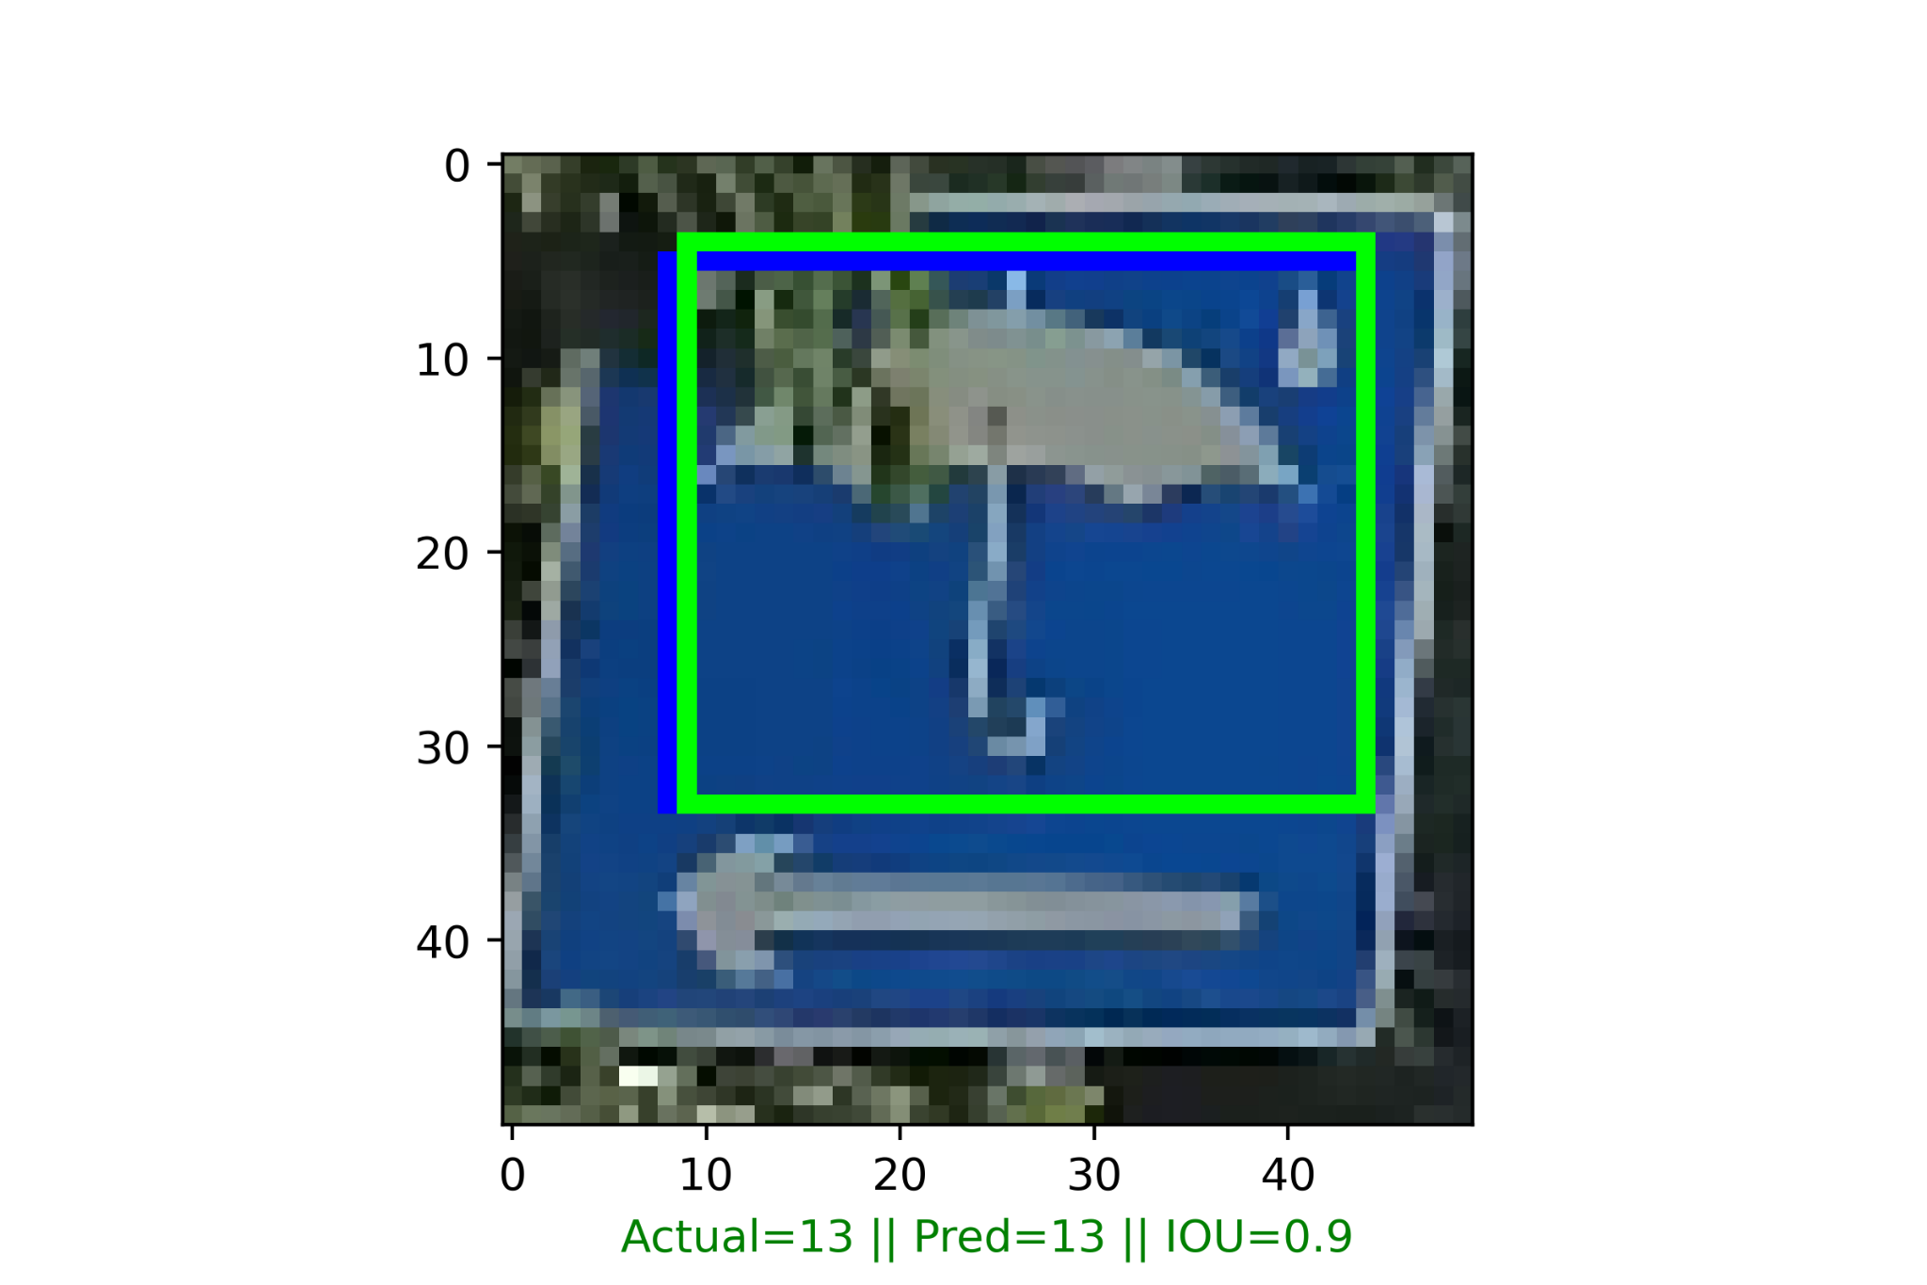
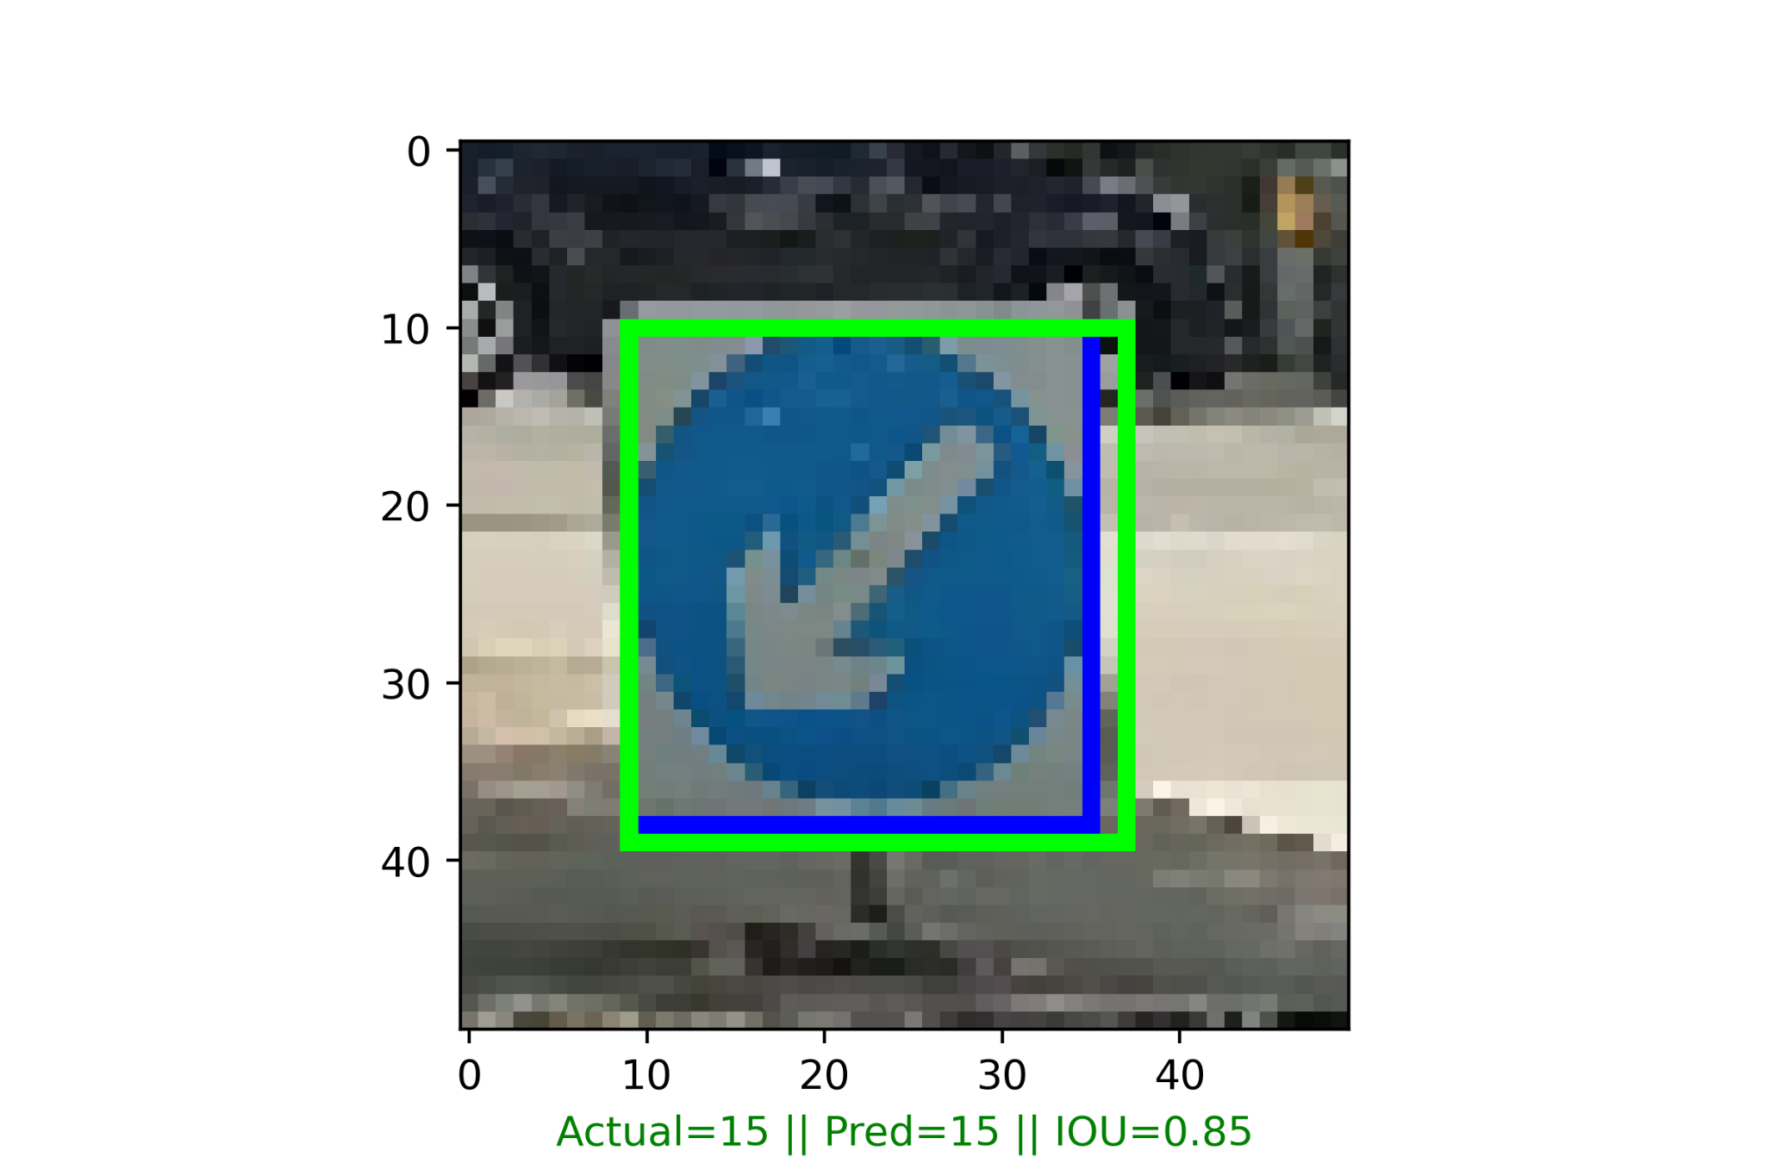
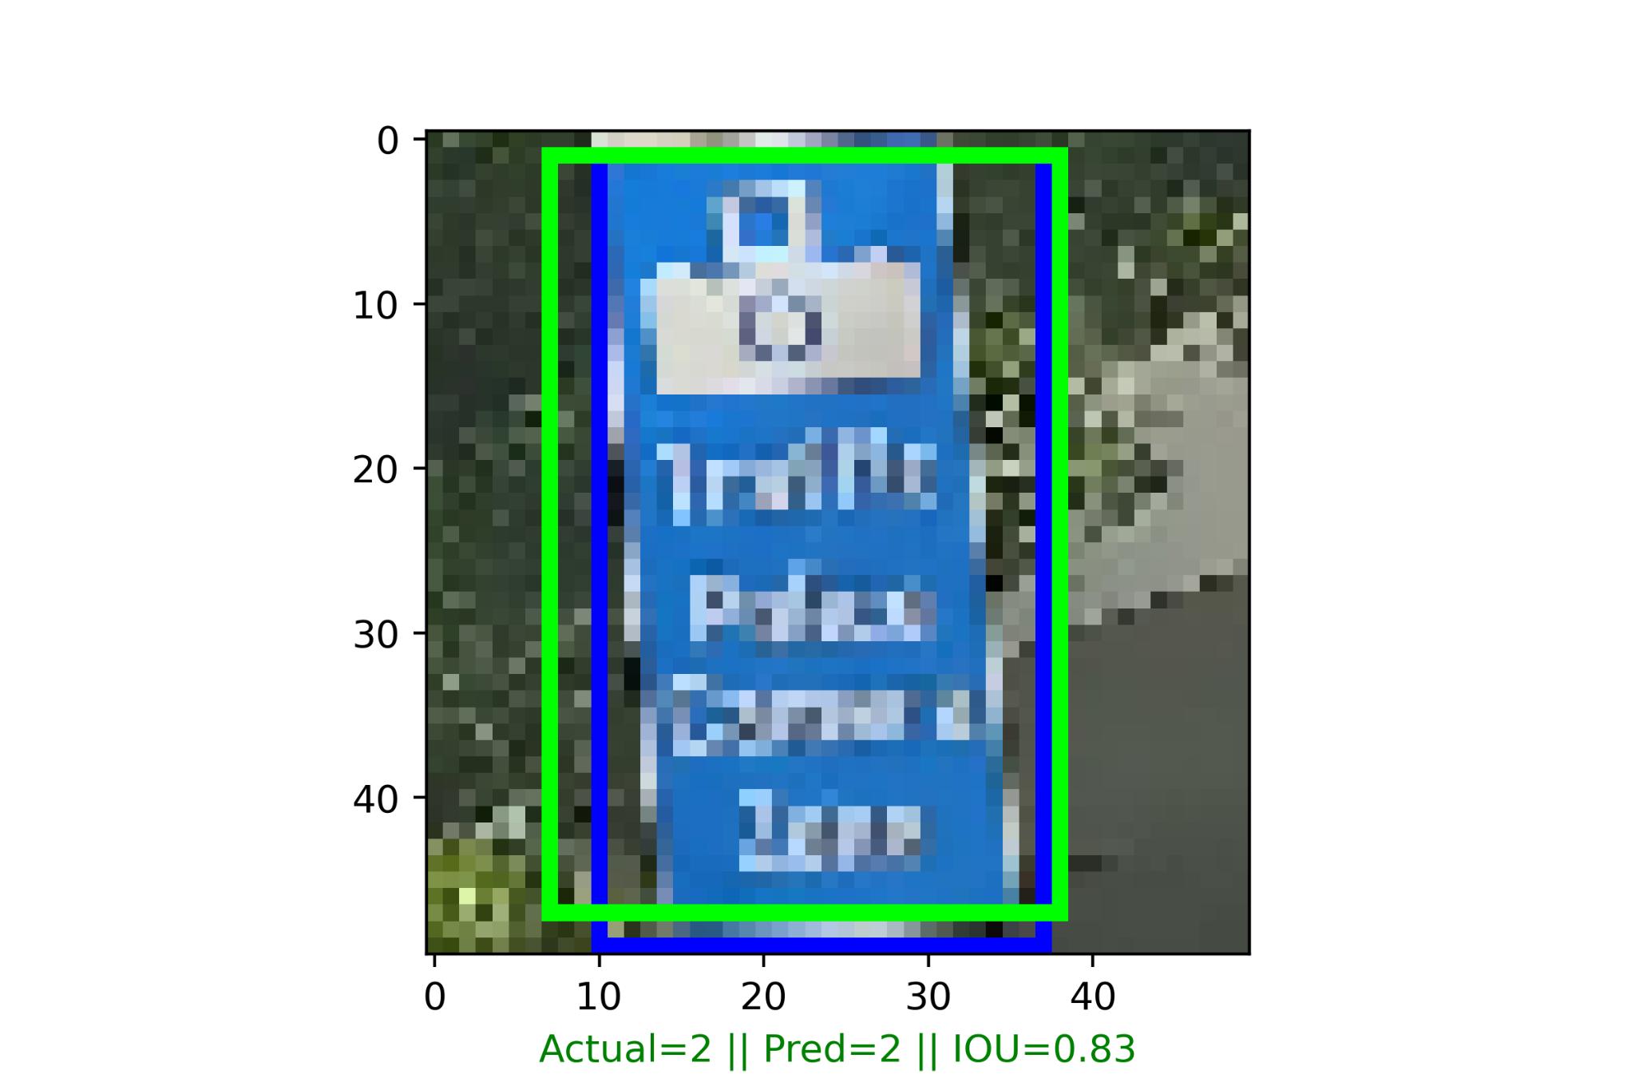
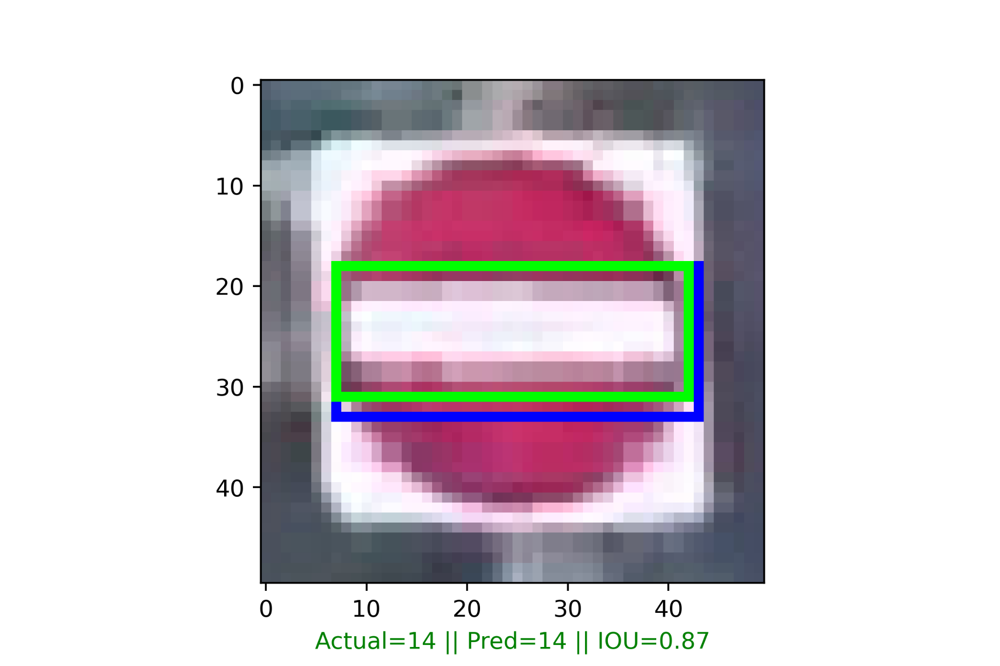
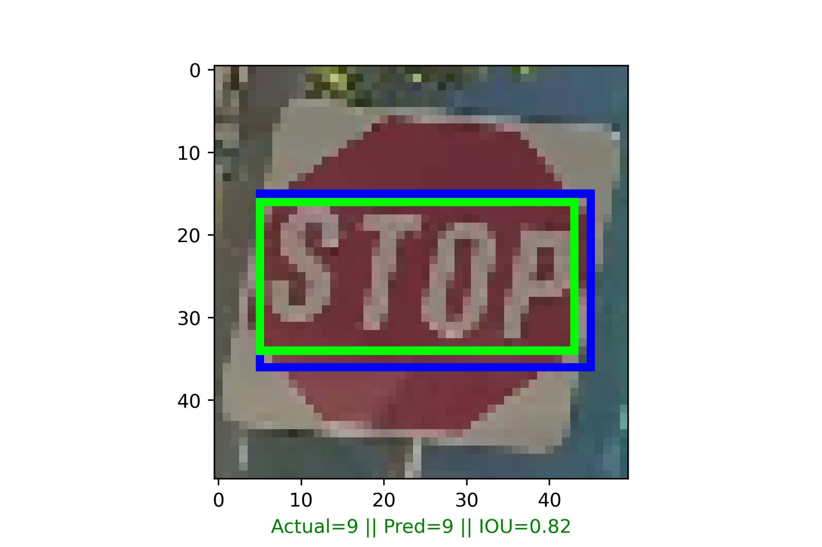
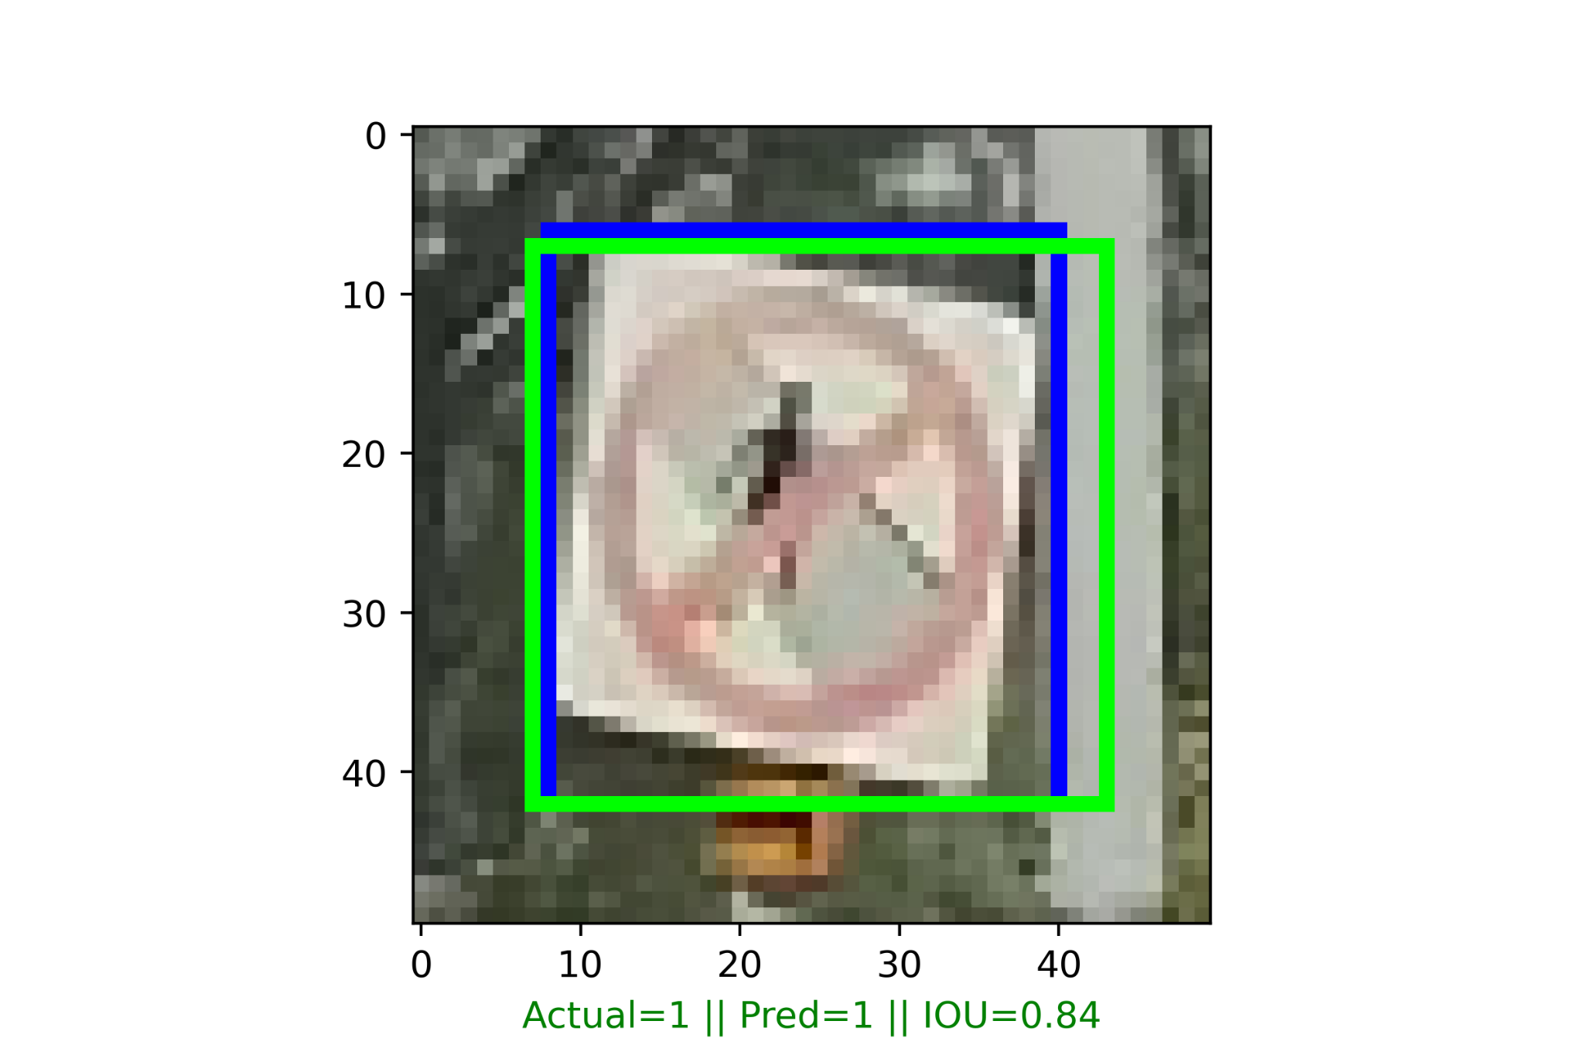
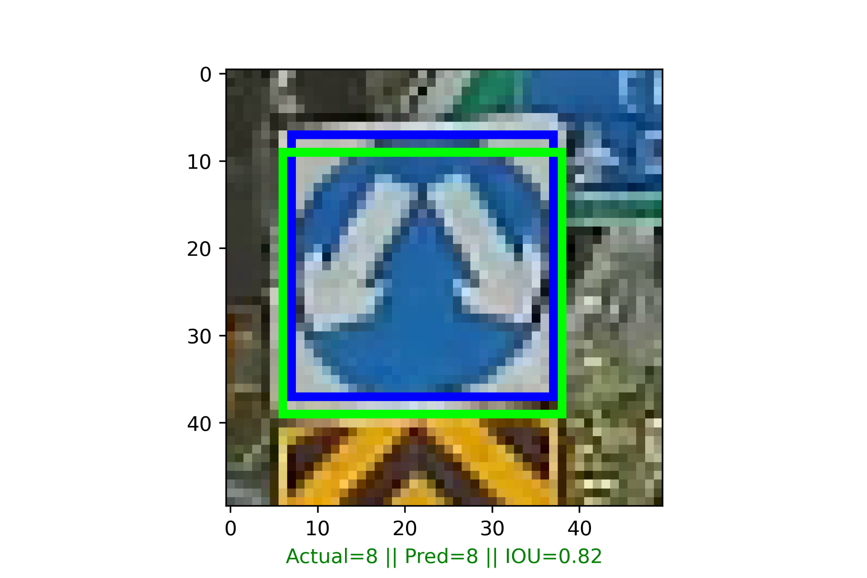
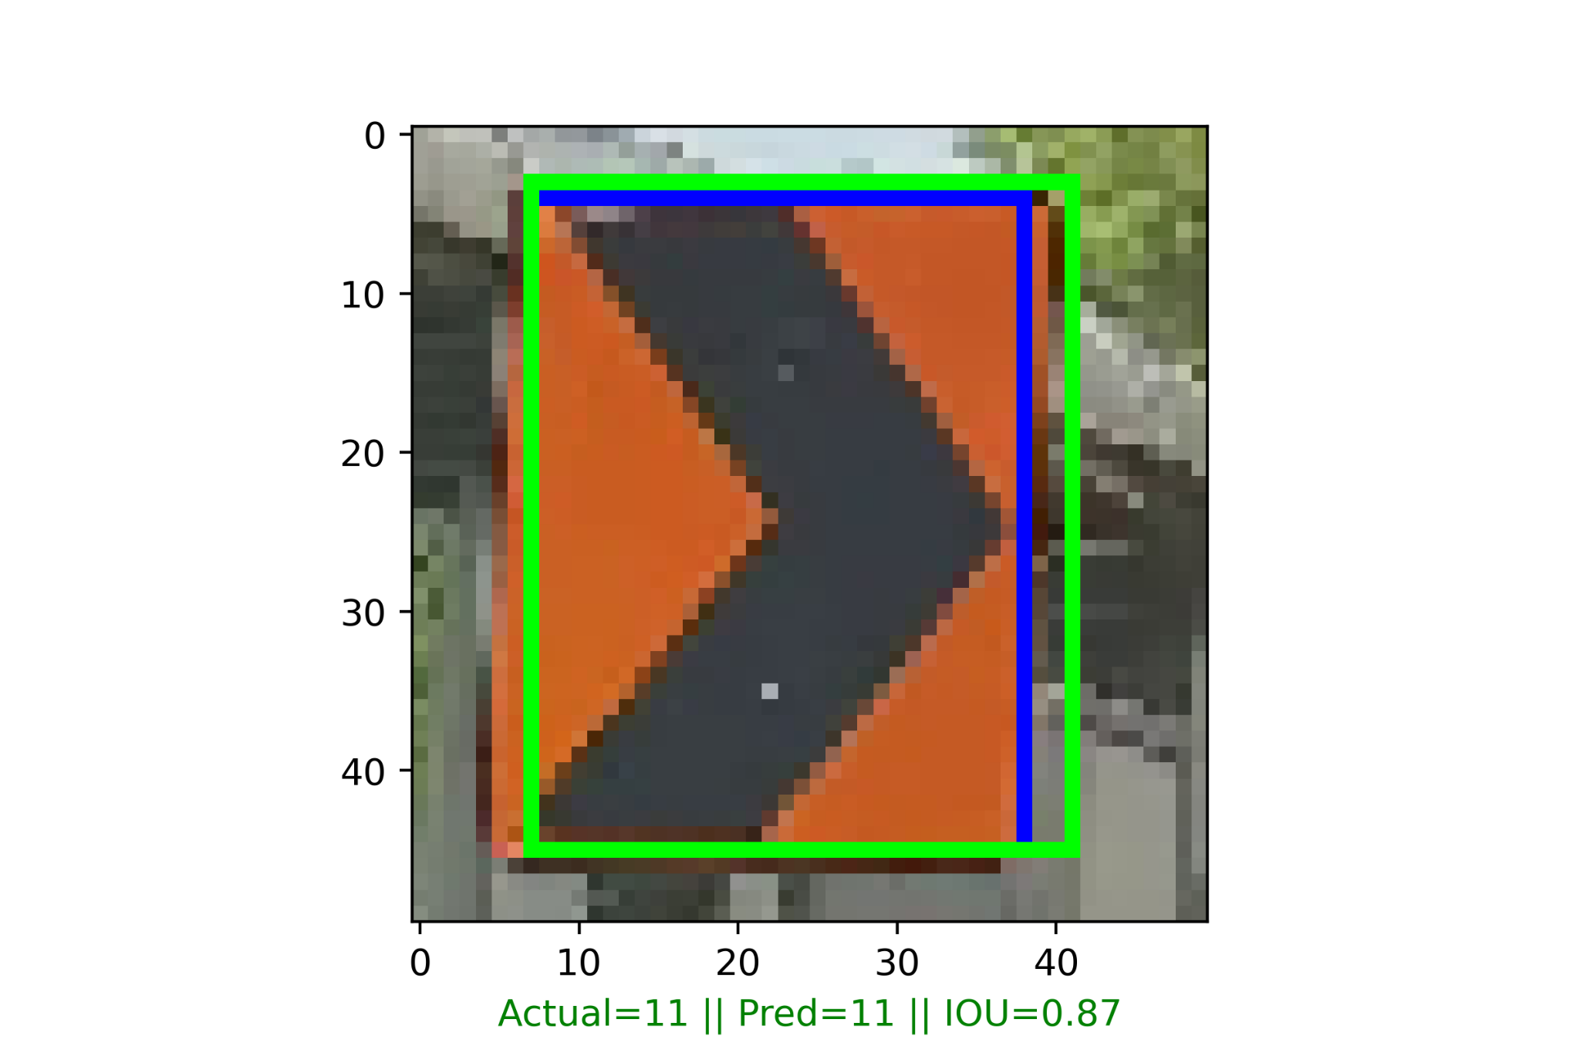
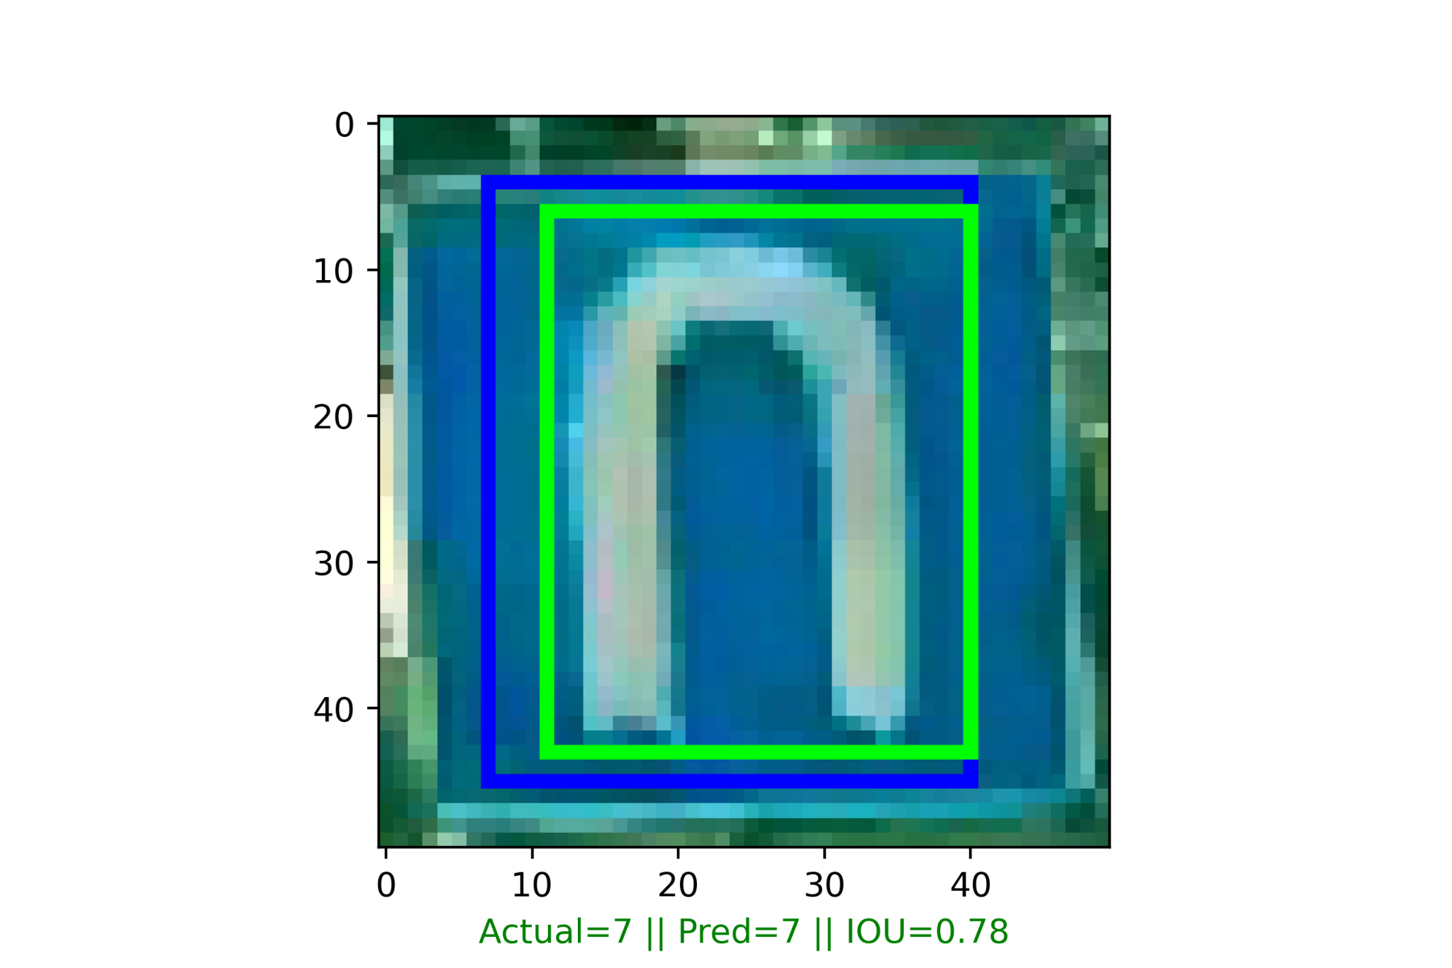
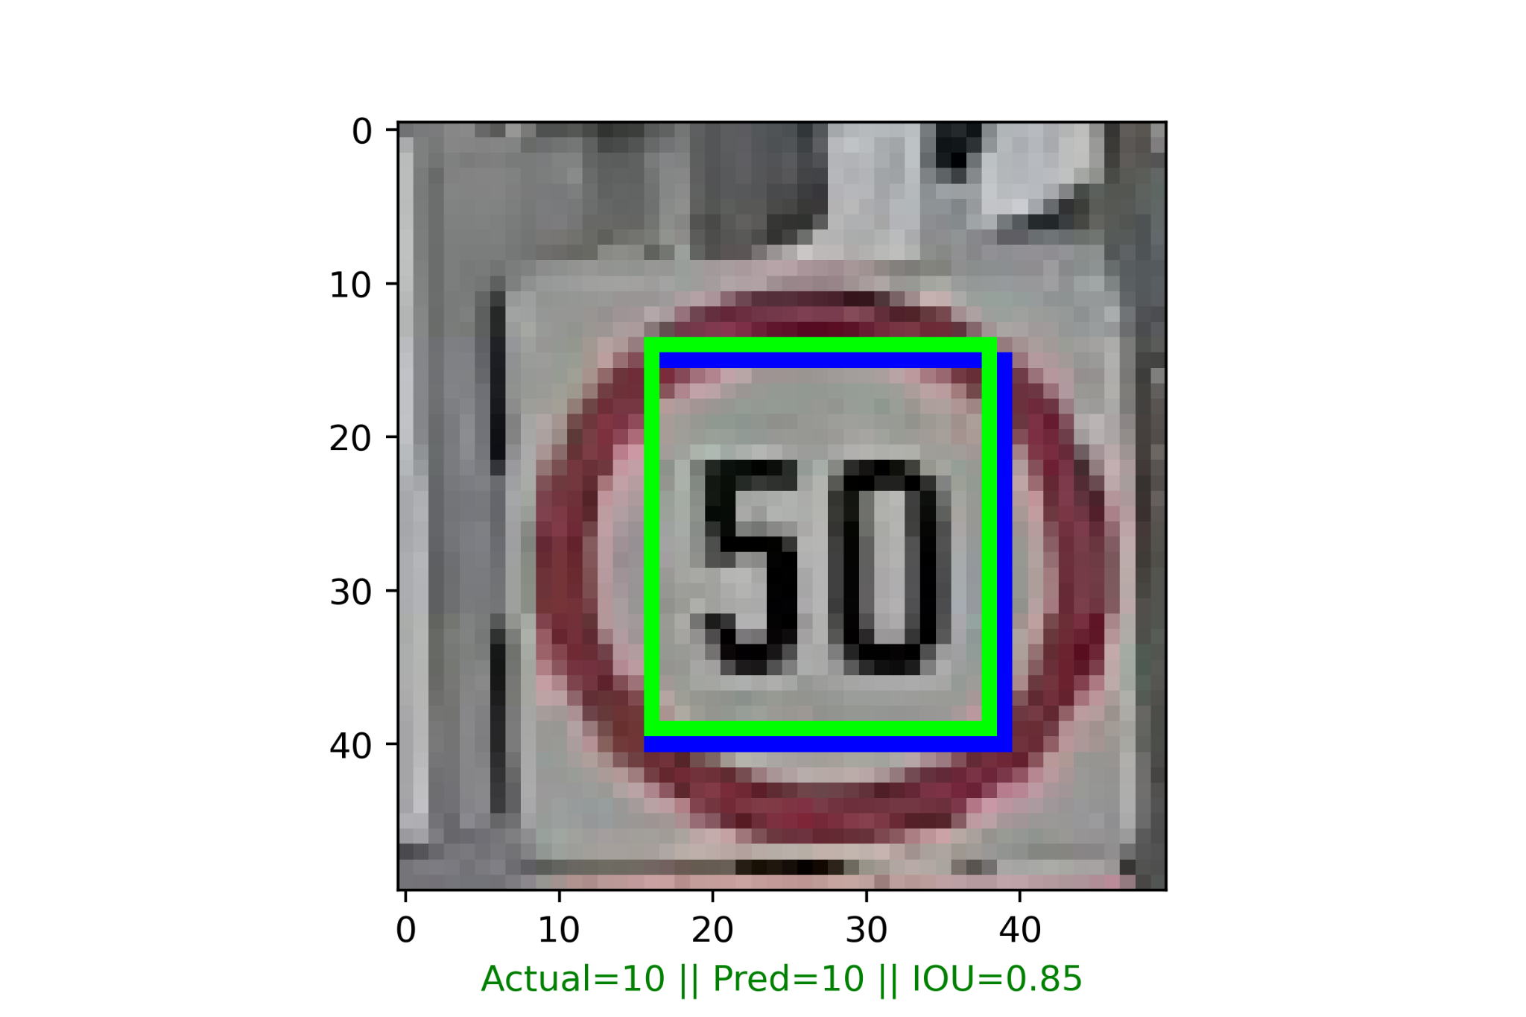
Classify & Localize
Blue - Groundtruth
Green - Predicted
Notes:
The validation images were evaluated, with the blue box representing the groundtruth and the green box representing the predicted bounding box.
The results were quite satisfactory, achieving an IoU between 0.8 to 0.9.

Slide 32
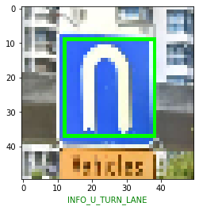
Classify & Localize - Blind test
Image was taken randomly from Google Street View.
Model managed to classify and localize the street sign.
Blind test results
Notes:
Next comes the blind test.
This image was taken from Google Street View near my house, and the model managed to classify and localize the street sign.

Slide 33
Metric - Fast R-CNN Architecture
Classification Accuracy score for 106 photos achieved:
0.97
IoU Accuracy score for 106 photos achieved:
0.88
Notes:
In the end, this model achieved a classification accuracy of 0.97 while the IoU achieved 0.88.

Slide 34
Building API
Notes:
Building the API

Slide 35
Structure of API
Local machine
Image render with bounding box vertices
Classification,
Bounding Box vertices
Image
Predict
Image class with bounding box
API
Notes:
The structure of the API was that the image was passed to the API in arrays.
The API makes a prediction and returns 5 values in JSON format.
Which is ‘The class, and 4 vertices of the bounding box’.
The image is then rendered locally with the bounding box.

Slide 36
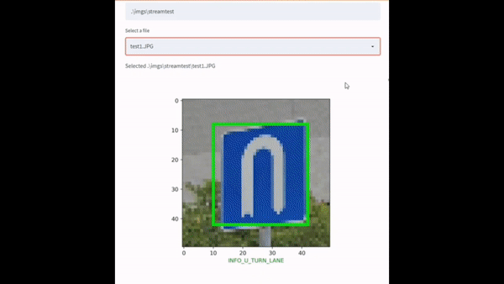
Deployment to Streamlit
Notes:
The model was deployed to Streamlit to test real time prediction.
This was the result.

Slide 37
Basic Object Tracking - OpenCV with YOLOv4 weights
Trajectory Tracking
Notes:
Finally, object trajectory tracking using YOLOv4.

Slide 38
Object Trajectory Tracking using Rule Based CV
By using the bounding box generated by YOLOv4:
By tracking the center of the bounding box, the trajectory of the bounding box can be tracked frame by frame.
Trajectory tracking was used to track the object if previous frame and current frame does not exceed 30 pixels.
Notes:
YOLOv4 is one of the fastest pretrained models giving us a high frame rate.
Building YOLOv4 from scratch is non-trivial hence, i’m using YOLOv4 pretrained weights to program object trajectory tracking.
Using the bounding box generated by YOLOv4, I tracked the center of the bounding box.
And the trajectory of the bounding box was tracked frame by frame.
The same object ID was assigned to the detected object when the previous and current frame does not exceed 30 pixels.

Slide 39
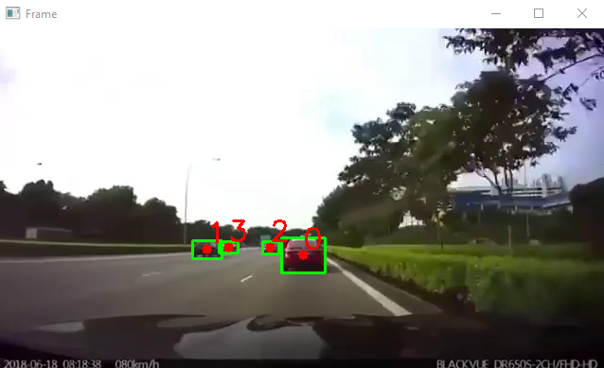
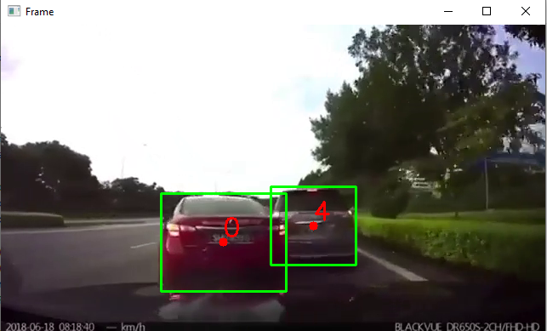
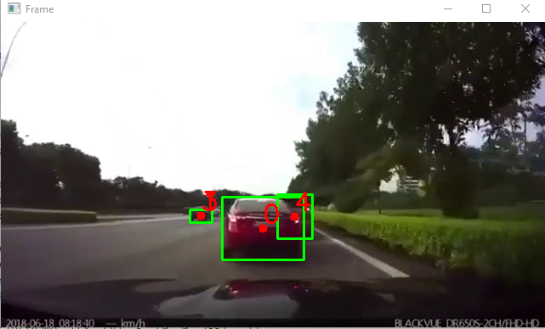
OpenCV with DNN module - YoloV4 weights
Notes:
This was the results.

Slide 40
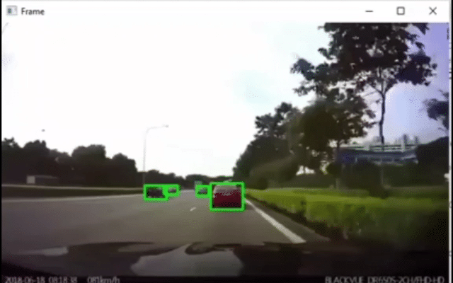
OpenCV with DNN module - YoloV4 weights
Notes:
This was the results.
As we can see here, even when the car moves out of its lane, its object ID remains the same.
The bounding box size growth also gives this project potential to grow as it can become a collision box detection to give drivers early warning.

Slide 41
Conclusion
In conclusion, from this project, it can be seen that the objectives intended were achieved.
The model was built without using transfer learning from pretrained models. And this solidified the foundation of understanding the architecture of Fast R-CNN models.
Object tracking was successful and managed to track objects even as it moves to the next lane.
Notes:
In conclusion, from this project, it can be seen that the objectives intended were achieved.
The model was built without using transfer learning from pretrained models. And this solidified the foundation of understanding the architecture of Fast R-CNN models.
Object tracking was successful and managed to track objects even as it moves to the next lane.

Slide 42
Future Works
1. Lane keeping
2. Image Segmentation with Mask R-CNN
3. Stereo Camera Depth Detection
4. LiDAR point clouds using DBSCAN combined with camera vision system for accurate object detection & tracking
Potential developments for this project includes, cameras and LiDAR that can be merged with precise alignment to become what is known as a fusion sensor so that the rate of false positives & false negatives can be minimized.
Combined with LiDAR point clouds and ML methods like DBSCAN, the accuracy of object detection and tracking has been better than ever, even in bad weather conditions.
Deployment would be useful if it can be deployed on embedded systems eg. FPGA in the automotive industry and can be researched further. [d]
Notes:
Future works for this project includes:
Lane keeping using rule based approach and deep learning methods
Image segmentation with Mask R-CNN which expands upon the current Functional API model architecture
Stereo camera depth perception
LiDAR point clouds using DBSCAN combined with computer vision.
Developments includes what is known as a fusion sensor between Computer Vision and LiDAR, so accuracy can be improved even in bad weather conditions.
Deployment can be useful if it can be deployed onto embedded systems and can be researched further.

Slide 43
Thank you!
Notes:
Thank you!

Slide 44
Sources

Slide 45
Sources:
[1] https://traveltips.usatoday.com/air-travel-safer-car-travel-1581.html#:~:text=In%20absolute%20numbers%2C%20driving%20is,air%20travel%20to%20be%20safer.
[2] https://towardsdatascience.com/r-cnn-fast-r-cnn-faster-r-cnn-yolo-object-detection-algorithms-36d53571365e
[3] https://towardsdatascience.com/region-of-interest-pooling-f7c637f409af
[4] https://towardsdatascience.com/with-keras-functional-api-your-imagination-is-the-limit-4f4fae58d90b
[5] https://towardsdatascience.com/review-mobilenetv2-light-weight-model-image-classification-8febb490e61c
[6] https://medium.com/analytics-vidhya/train-a-custom-yolov4-object-detector-using-google-colab-61a659d4868
[7] https://traveltips.usatoday.com/air-travel-safer-car-travel-1581.html
[8] https://medium.com/analytics-vidhya/iou-intersection-over-union-705a39e7acef
[9] https://medium.datadriveninvestor.com/2-layers-to-greatly-improve-keras-cnn-1d4d1c3e8ea5

Slide 46
Sources:
[10] https://towardsdatascience.com/the-vanishing-exploding-gradient-problem-in-deep-neural-networks-191358470c11?gi=27e999e4010f
[11] https://developers.google.com/machine-learning/crash-course/multi-class-neural-networks/softmax
[12] https://towardsdatascience.com/understand-your-algorithm-with-grad-cam-d3b62fce353#:~:text=Gradient%2Dweighted%20Class%20Activation%20Mapping,regions%20in%20the%20image%20for
[13] https://arxiv.org/pdf/1610.02391.pdf
[14] https://towardsdatascience.com/fast-r-cnn-for-object-detection-a-technical-summary-a0ff94faa022
[15] https://github.com/tzutalin/labelImg
[16] https://towardsdatascience.com/what-is-the-difference-between-object-detection-and-image-segmentation-ee746a935cc1

Slide 47
Sources:
[17] https://www.researchgate.net/figure/Object-tracking-based-on-image-segmentation-and-similar-object-feature-matching_fig1_4222458
[18] https://m.futurecar.com/4632/Computer-Vision-Developer-StradVision-to-Showcase-its-Most-Advanced-Perception-Camera-for-Autonomous-Driving-&amp;-ADAS-at-Auto-Tech-2021
[a] Research papers and materials: With great thanks to the following authors for sharing their research papers and materials on the topic of object classification and localization.
[b] Object Detection and Localization with Deep Networks, Avi Kak and Charles Bouman, Purdue University
[c] Universal Bounding Box Regression and Its Applications, Seungkwan Lee, Suha Kwak and Minsu Cho, Dept. of Computer Science and Engineering, POSTECH Korea
[d] Intelligent Vision Systems & Embedded Deep Learning Technology for ADAS, Jiun-In Guo, National Yang Ming Chiao Tung University

Slide 48
Sources:
[e] Grad-CAM: Visual Explanations from Deep Networks via Gradient-based Localization, Ramprasaath R. Selvaraju · Michael Cogswell · Abhishek Das · Ramakrishna Vedantam · Devi Parikh · Dhruv Batra
[f] Stereo RCNN based 3D Object Detection for Autonomous Driving, https://github.com/srinu6/Stereo-3D-Object-Detection-for-Autonomous-Driving

Slide 49

Sequential Model
Keras - Custom Convolution Layers
2 Important layers were used:
Batch normalization - Reduce overfitting
Dropout - Weight independent, due to randomly dropping weights
Softmax Activation for multi-class classification (32 classes)
There were a total of 3,707,136 trainable params
https://medium.datadriveninvestor.com/2-layers-to-greatly-improve-keras-cnn-1d4d1c3e8ea5
https://machinelearningmastery.com/how-to-accelerate-learning-of-deep-neural-networks-with-batch-normalization/

Slide 50
Modeling
https://www.tensorflow.org/api_docs/python/tf/keras/callbacks/EarlyStopping
https://towardsdatascience.com/learning-rate-schedules-and-adaptive-learning-rate-methods-for-deep-learning-2c8f433990d1
Using the following parameters with Adam:
Learning rate = 0.001
Epochs = 50
Callbacks = EarlyStopping, patience = 8, restore_best_weights
AMSGrad = True
Methods tested but got poor results:
Convolution layer was increased to 3 as 2 convolution layers caused the validation accuracy to diverge mid training
Learning rate was optimized to 0.001 as any higher learning rate couldn’t get the model to converge
Exponential decay and exponential learning rate was experimented but it was too unpredictable & not repeatable
Adding dropout in between layers to combat overfitting turned out to be too difficult for the model to improve validation accuracy as epochs increased)

